Slide 1

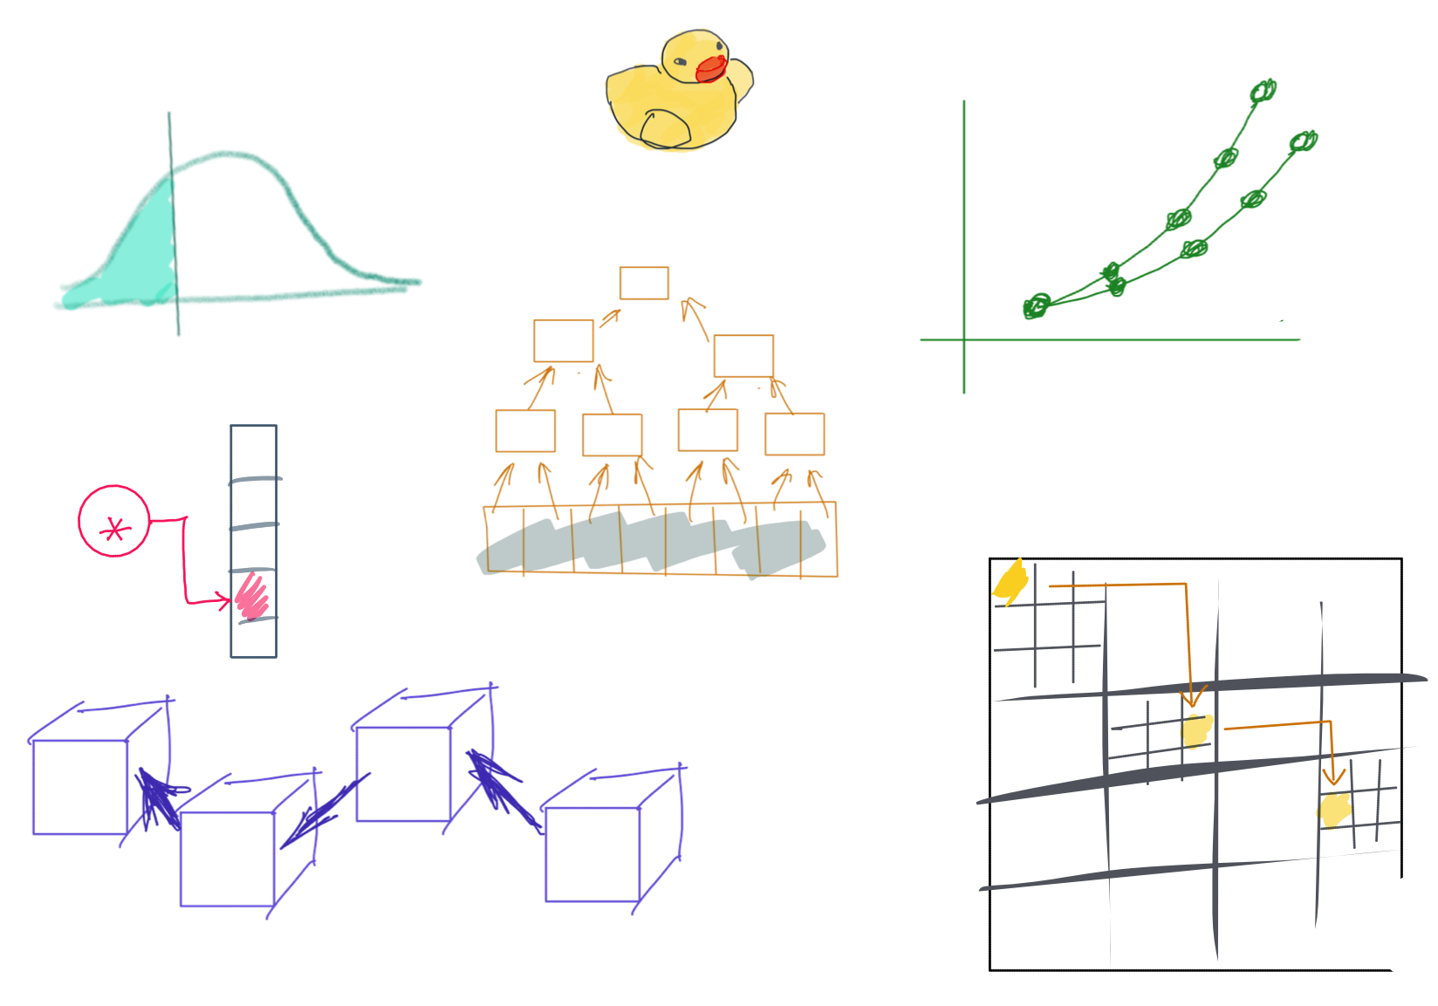

Slide 2
CSS342 Data Structures, Algorithms, and Discrete Mathematics (I)

Slide 3
Where are we at now?
ADT (array vs list)
One-dimensional ADT
ArrayList
Stack
LinkedList
Queue
Hash table
Recursion
Search Problem
Sorting
Binary tree
multi-dimensional ADT

Slide 4
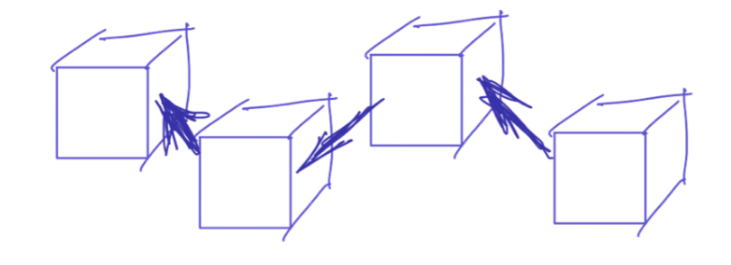
^{5th} Week Schedule
Homework 2 Review (Wed)
ADT List (single linked list) (Wed)
ADT Queue and Stack (Fri)
Quiz-2 (Thur, 4/28). See Discord #quiz-2 for details.
Homework 3 to be assigned on Fri around noon

Slide 5

Homework 2 Review

Slide 6



The Formula
Monthly deposit
$$×$$
12
+
Initial Deposit
Annual deposit
$$×$$
annual increase rate
Yearly deposit

Slide 7
Compounding Interest
Year 0
Year 1
Initial value
rate %
Initial deposit for year 0
annual contribution

Slide 8
Compounding Interest
Year 0
Year 1
Year 2
Initial value
rate %
annual contribution

Slide 9
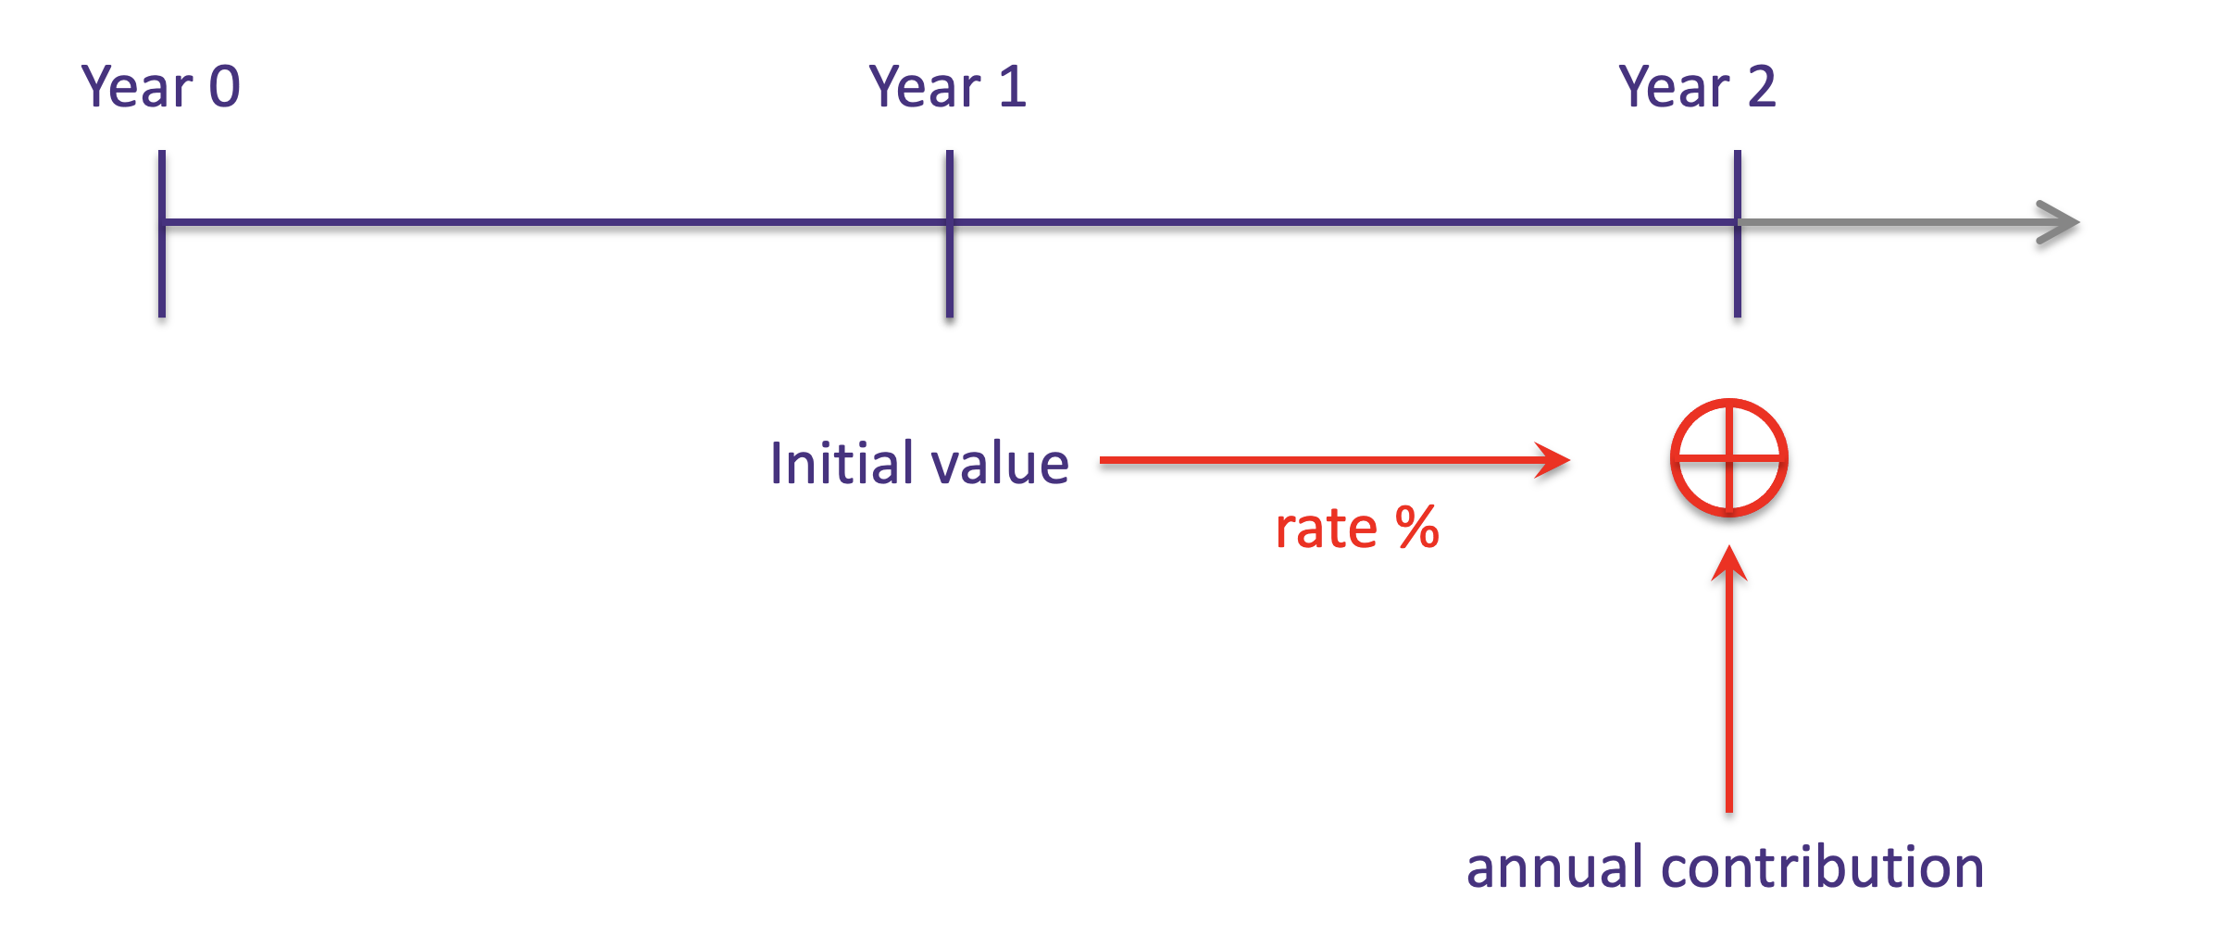
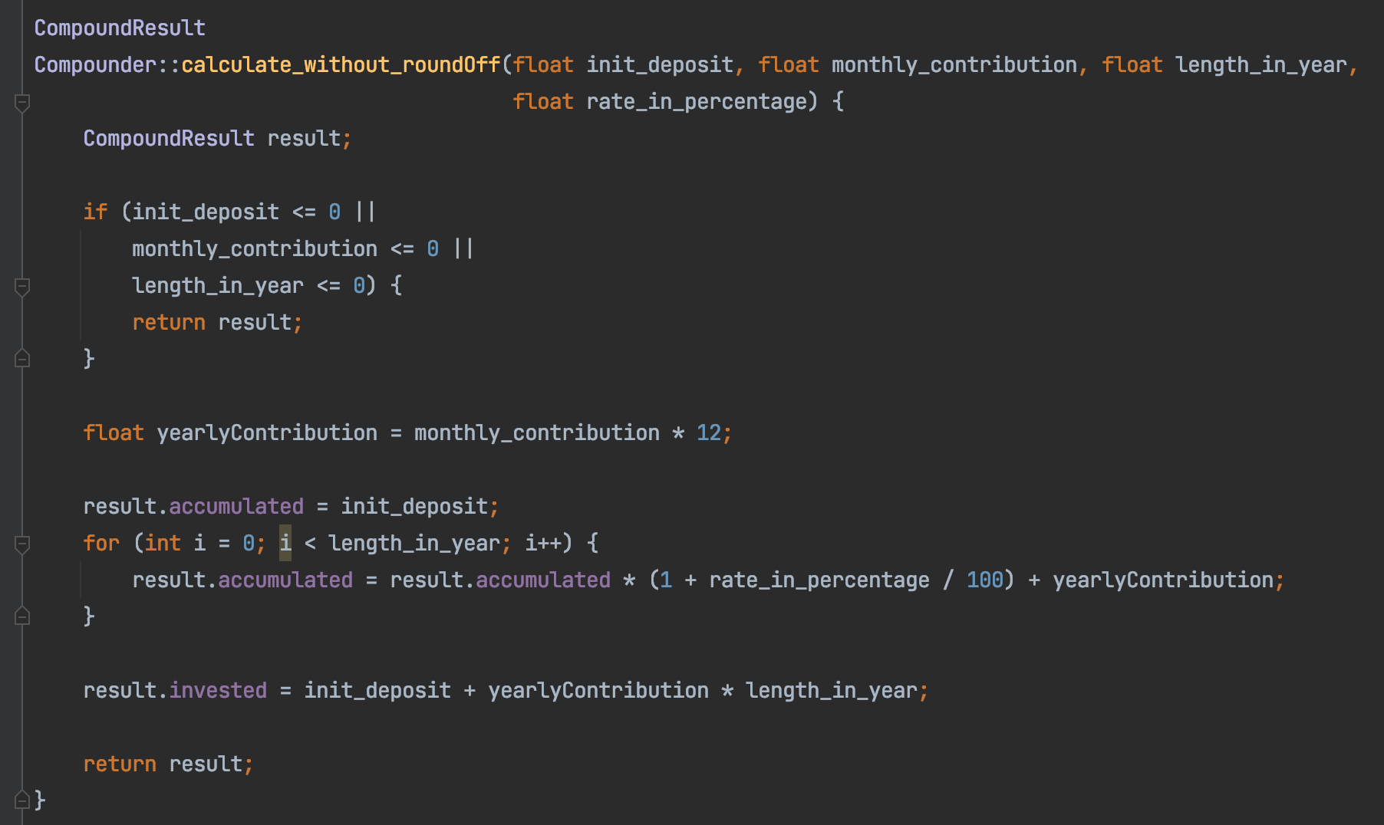

Slide 10
Compound Interest
What’s your take?
“Money isn’t all that useful unless you know what to do with it.”
- Jordan Peterson
“The best thing money can buy is your (financial) freedom.”
- Rob Berger

Slide 11
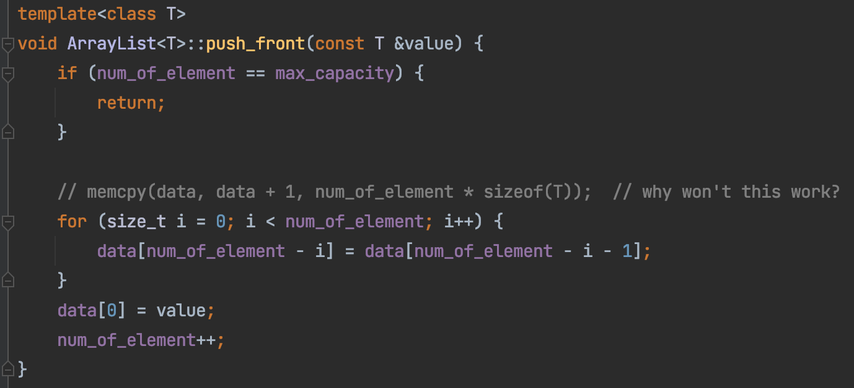
List & ArrayList
push_front
20
8
3
35

Slide 12
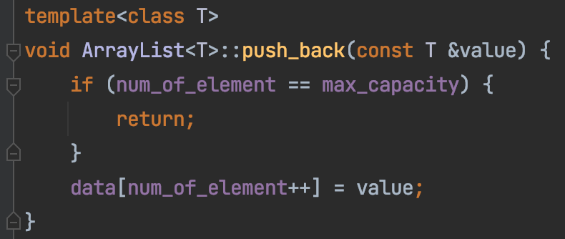
List & ArrayList
push_back
20
8
3
35

Slide 13
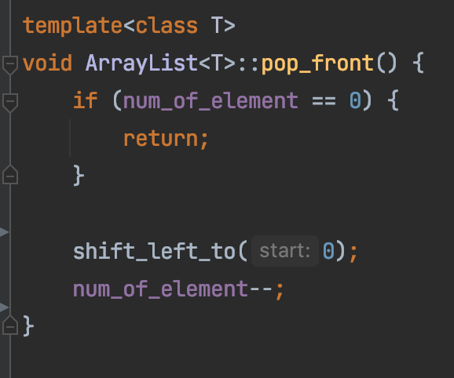
List & ArrayList
pop_front
20
8
3
35

Slide 14
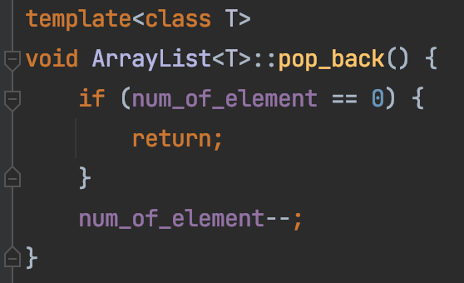
List & ArrayList
pop_back
20
8
3
35

Slide 15
List & ArrayList
2
8
9
12
33
-1
4
13
merge
-1
2
4
8
9
12
13
33
Code here

Slide 16
Design a system to store a set of user id
User id: 8, 35, 20, 7
Assumption:
Integer to store user id
Requirement:
Fast search
Fast insertion/deletion
Binary Search
Bubble Sort
ArrayList

Slide 17
Design a system to store a set of user id
User id: 8, 35, 20, 7
7
8
20
35

Slide 18
Design a system to store a set of user id
User id: 8, 35, 20, 7
7
8
20
35
Insert 13 here

Slide 19
Design a system to store a set of user id
User id: 8, 35, 20, 7
7
8
13
20
35
What if array has 1 million user ids and we are constantly inserting to the front

Slide 20

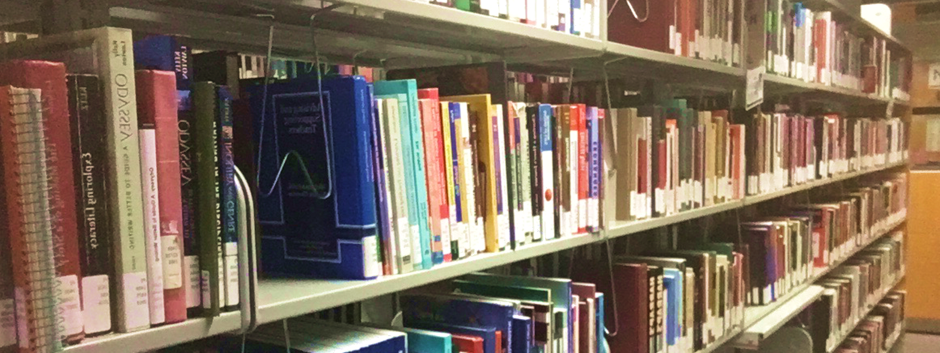
Array vs List
12
12
1
7
18
10
3
Array index
0
1
2
3
4
5
6
Memory address (Hexadecimal)
0x00
0x04
0x08
0x0C
0x10
0x14
0x18

Slide 21
Design a system to store a set of user id
7
8
20
35
Insert 13 here
Problem:
memory copy is very SLOW
Visit too many elements

Slide 22
Array → List
12
12
1
7
18
10
3
head
12
12
12
1
7
18
10
3
null
value
“Node”
reference

Slide 23
Single Linked List
Head (Dummy node)
12
1
4
2
null
value
“Node”
reference

Slide 24
12
1
7
3

Slide 25
Memory Layout
list
array
Memory space

Slide 26
Memory Layout
addr0
12
addr1
addr8
addr2
addr3
addr4
7
addr0
addr5
addr10
addr1
12
addr6
head
addr2
12
addr0
addr7
addr3
12
1
addr8
addr4
1
addr4
addr9
addr5
7
18
addr10
addr6
18
addr11
addr14
addr7
10
addr12
3
addr8
3
addr13
null
addr9
addr14
10
addr10
addr15
addr12
array
list
addr16

Slide 27
Array vs List
Array:
Contiguous in memory
Fast random access
Fixed size
12
12
1
7
18
10
3
head
12
12
1
7
18
10
3
nullptr
LinkedList:
Random addressed in memory
No random access
Size not fixed
More comparison between array and linked list

Slide 28
Single Linked List vs Double Linked List
head
12
12
1
7
18
10
3
Single/Singly Linked List
nullptr
head
12
12
1
7
18
10
3
null
nullptr
Double/Doubly Linked List

Slide 29
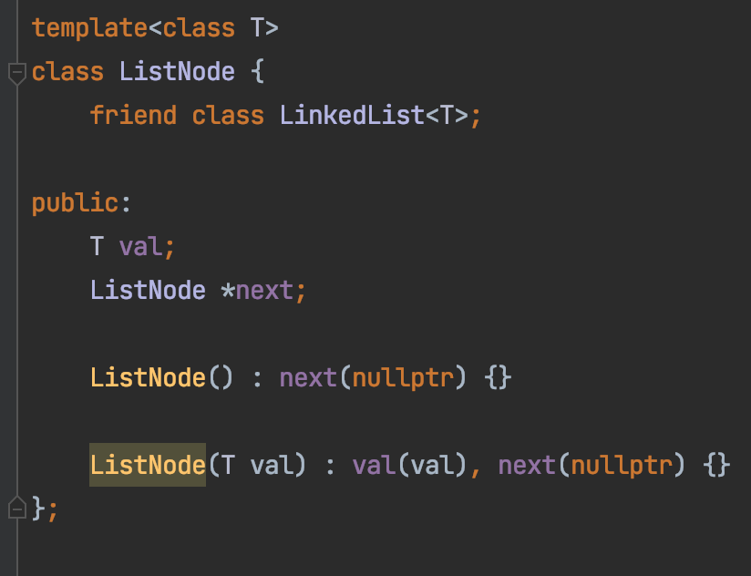
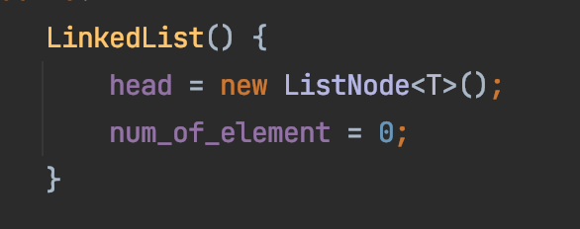
Functions to study:
head
nullptr
nullptr

Slide 30
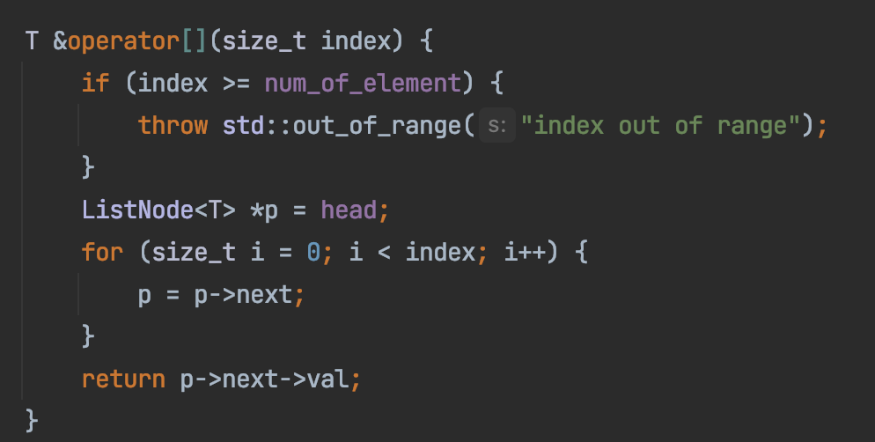
Functions to study:
head
nullptr

Slide 31
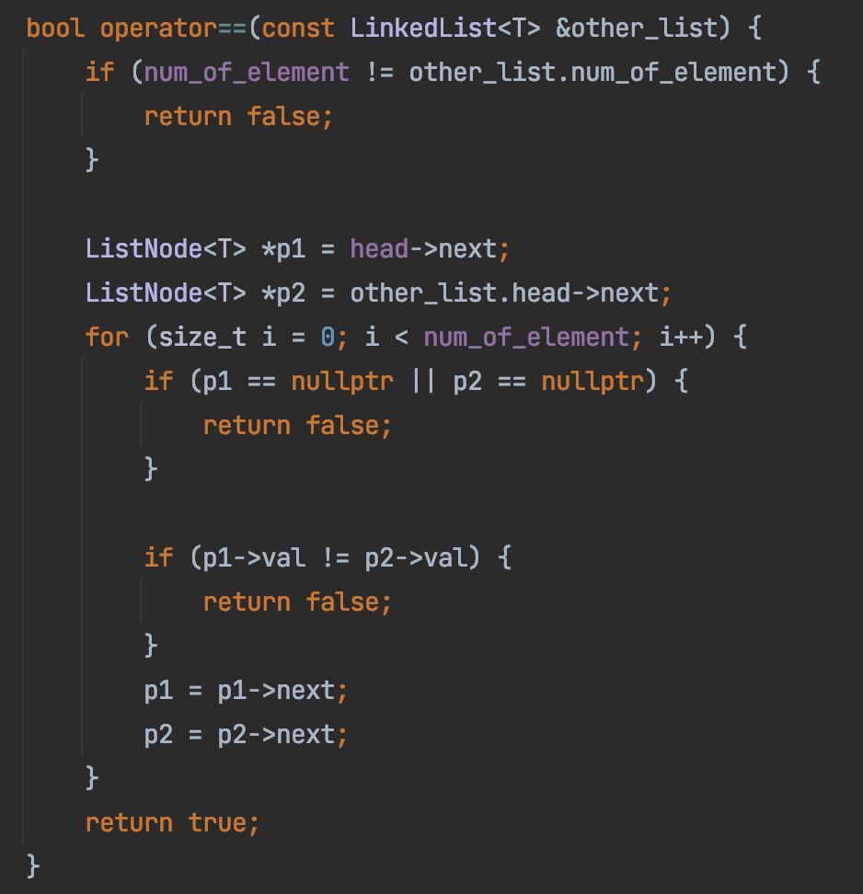
Functions to study:
head
nullptr
head
nullptr

Slide 32
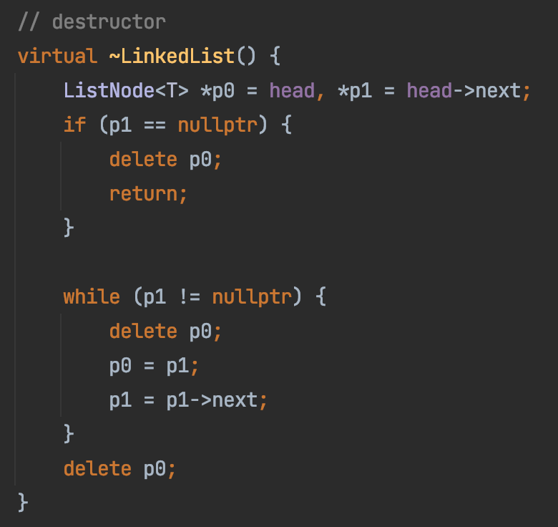
Functions to study:
head
nullptr

Slide 33
Performance Validation
add(0, val)
Linear time
head
nullptr
add(0, val)
Constant time

Slide 34
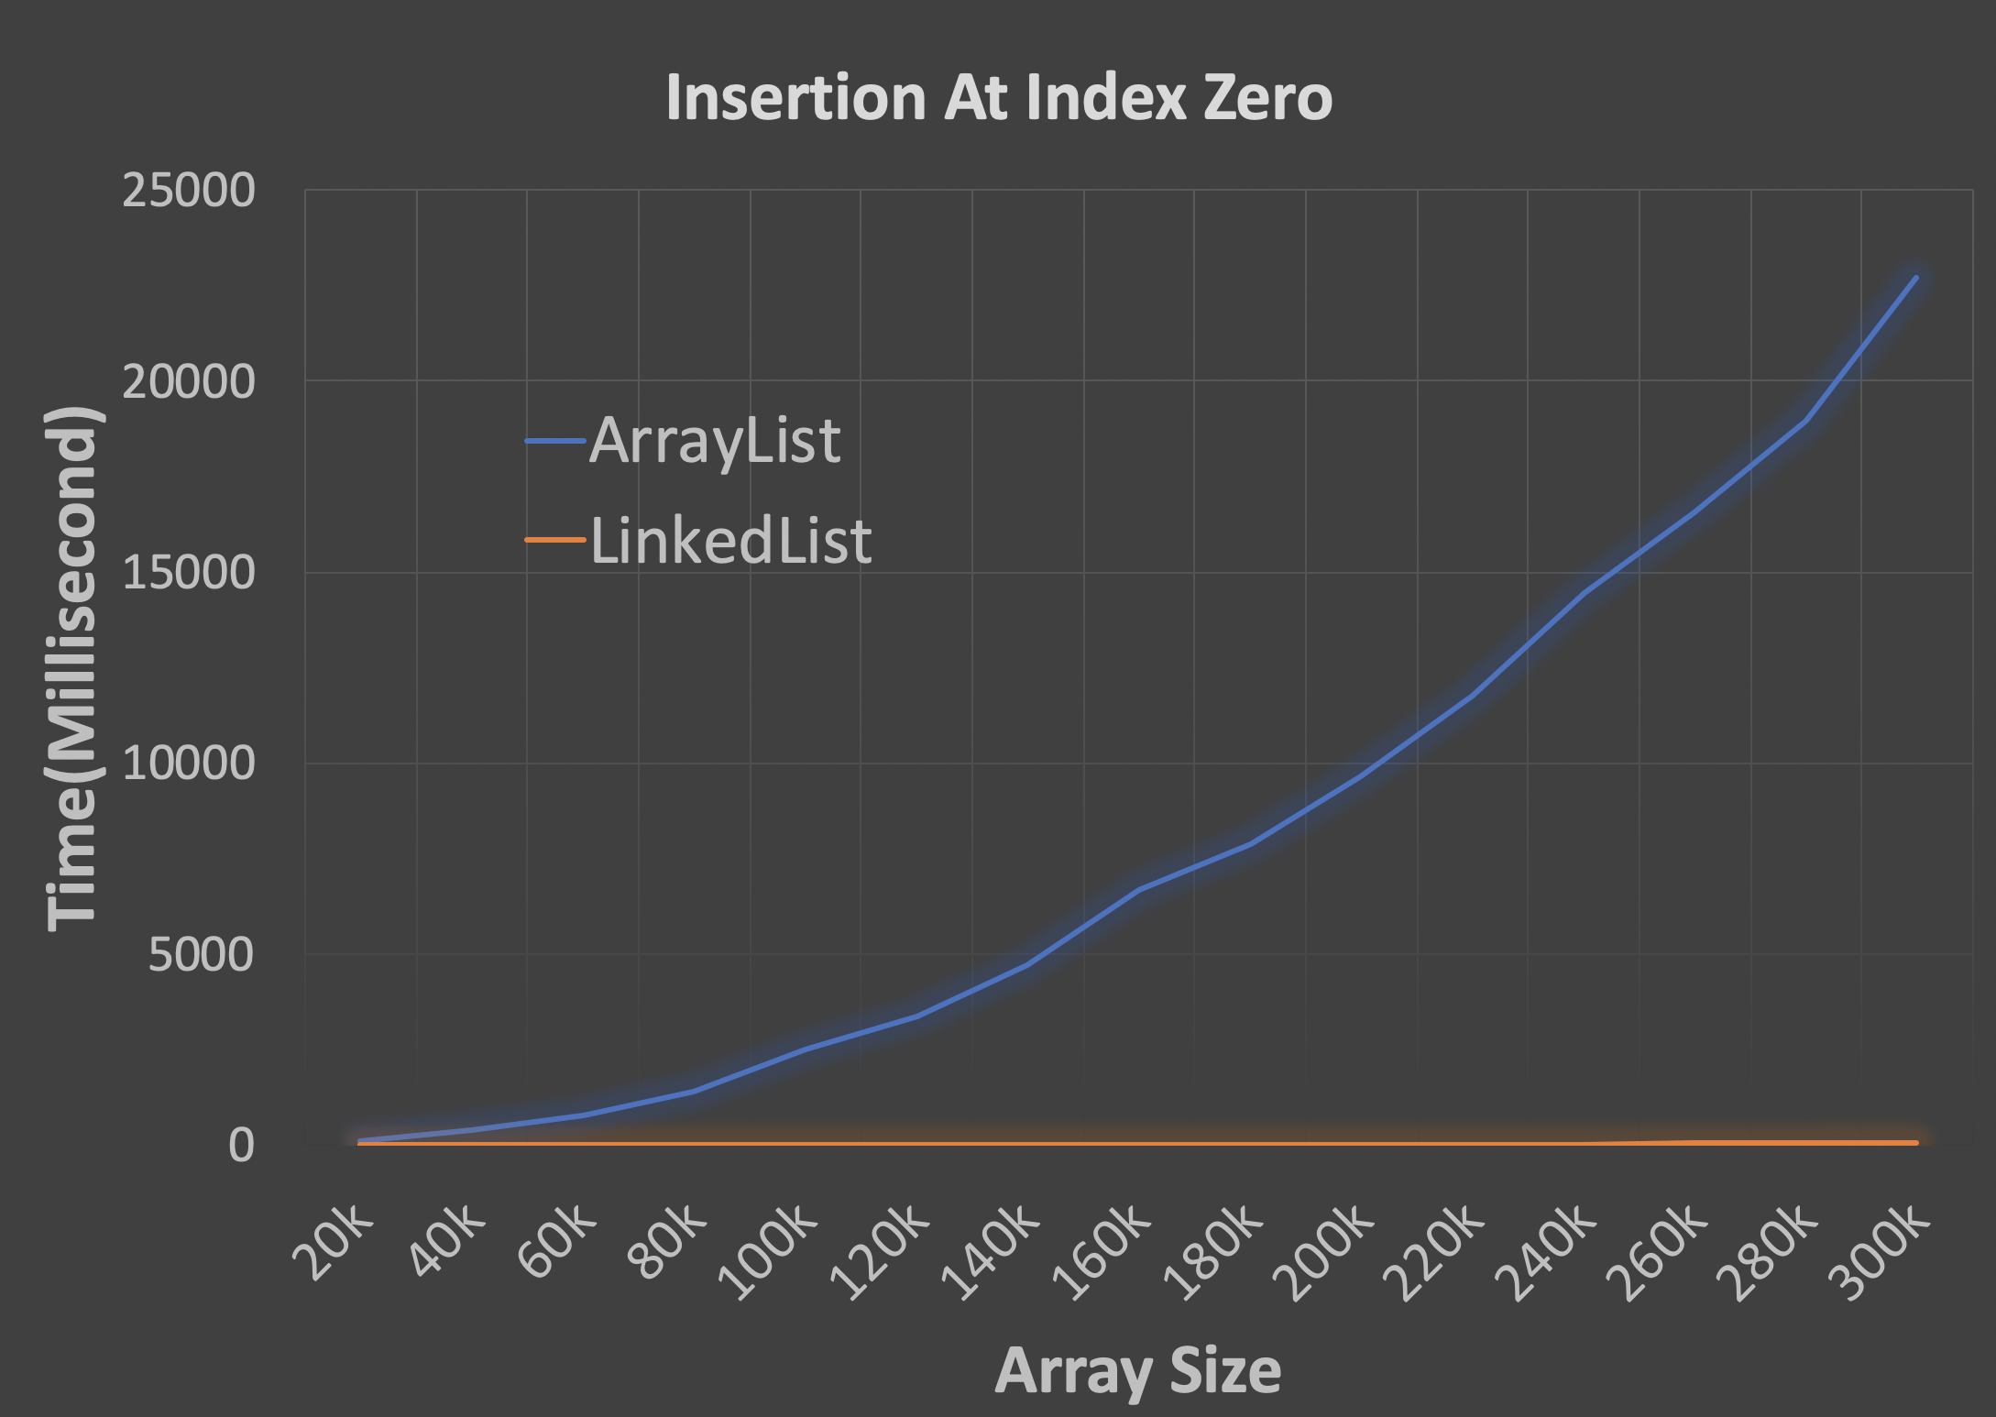
Performance Validation

Slide 35

Practice
Print out the values of a single linked list
Front to back: 1, 4, 2
Back to front: 2, 4 1
1
4
2
nullptr
Code here

Slide 36

Parkinson’s Law
“Work complicates to fill the available time.”
Given 4 days, I’ll start work on day 3
Given 7 days, I’ll start work on day 6
Given 10 days, I’ll start work on day 9

Slide 37
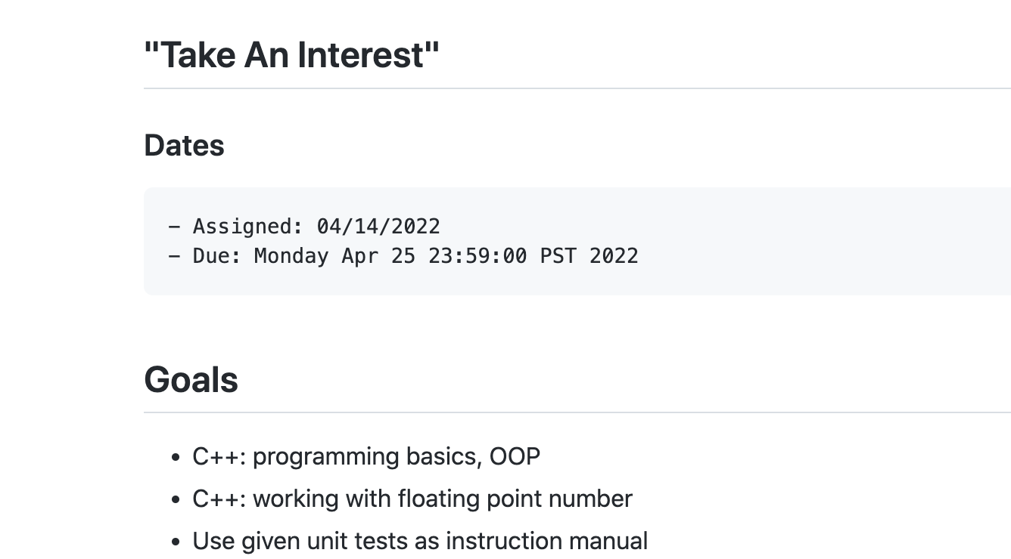
Parkinson’s Law
Given 11 days,
how many days did you give yourself for homework 3?
A. 1 day
B. 2 day
C. 4 day
D. 5+ day

Slide 38
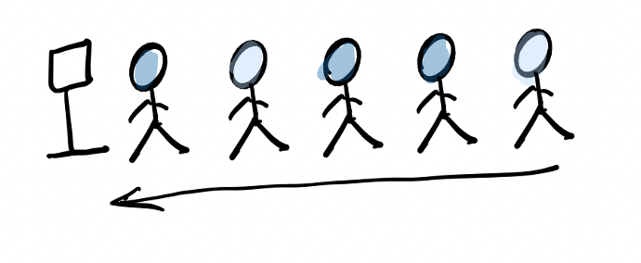
ADT: Queue
First In First Out (FIFO)

Slide 39
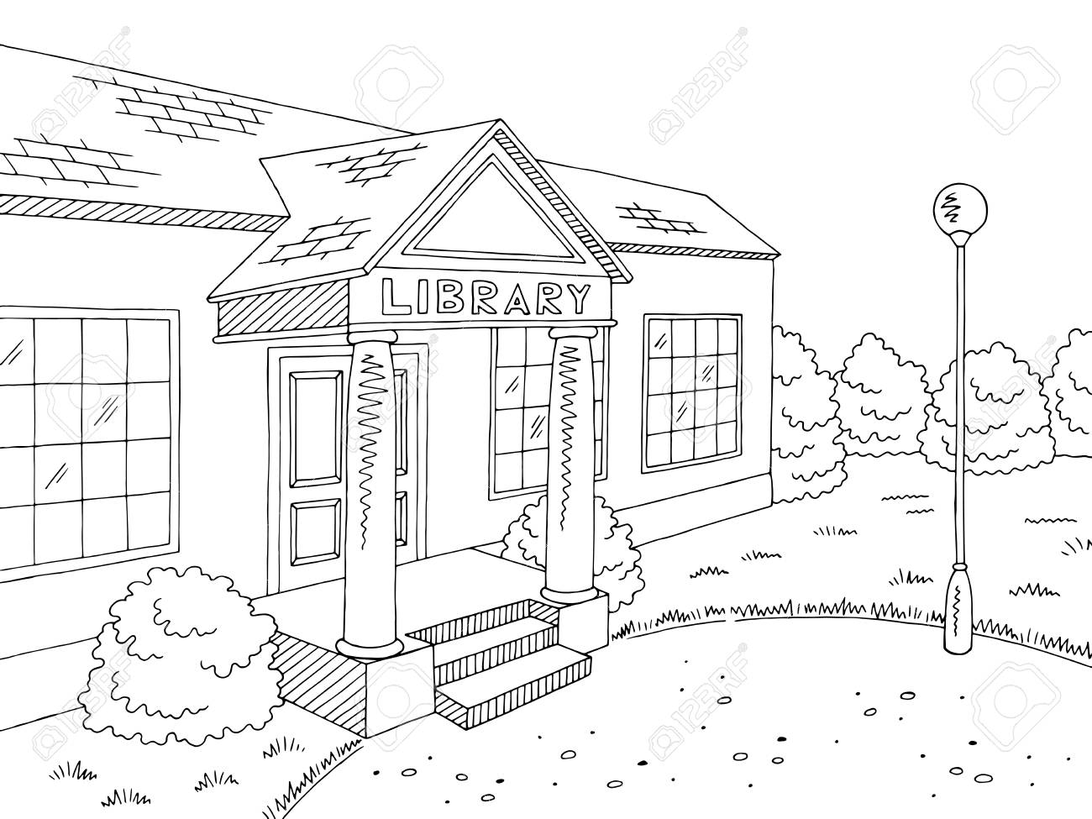
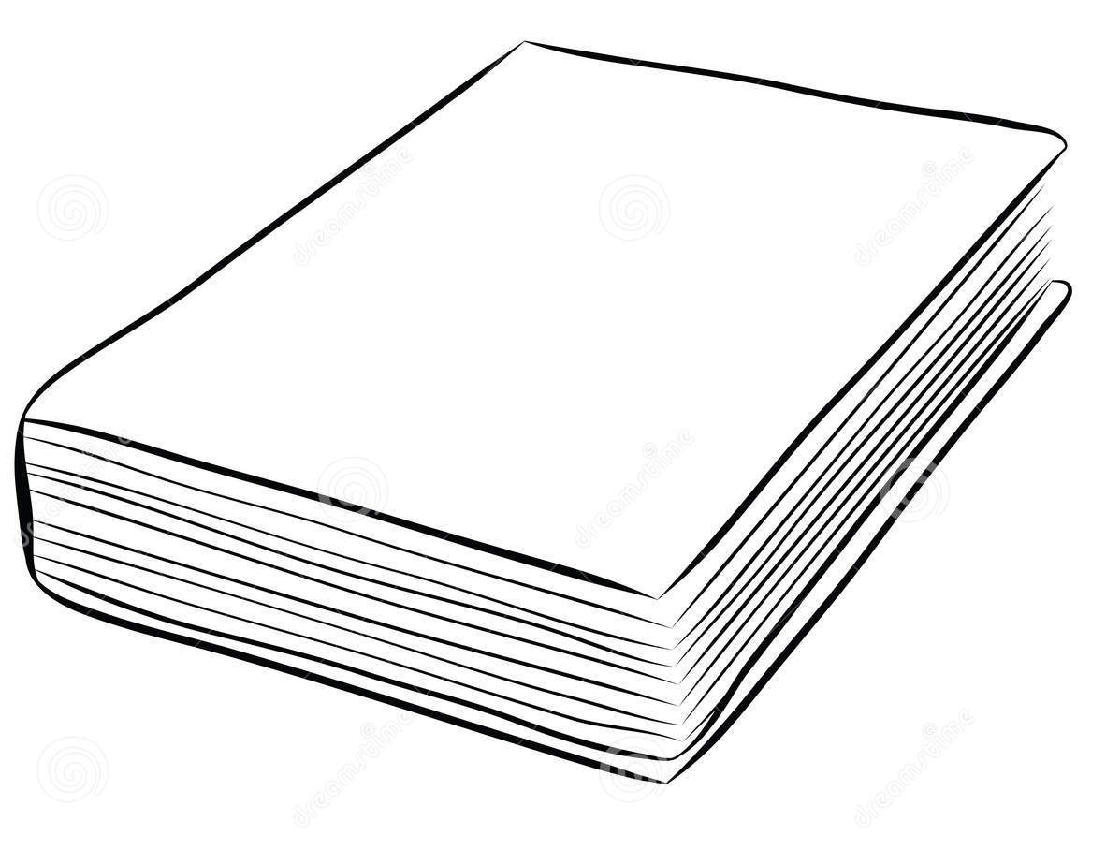
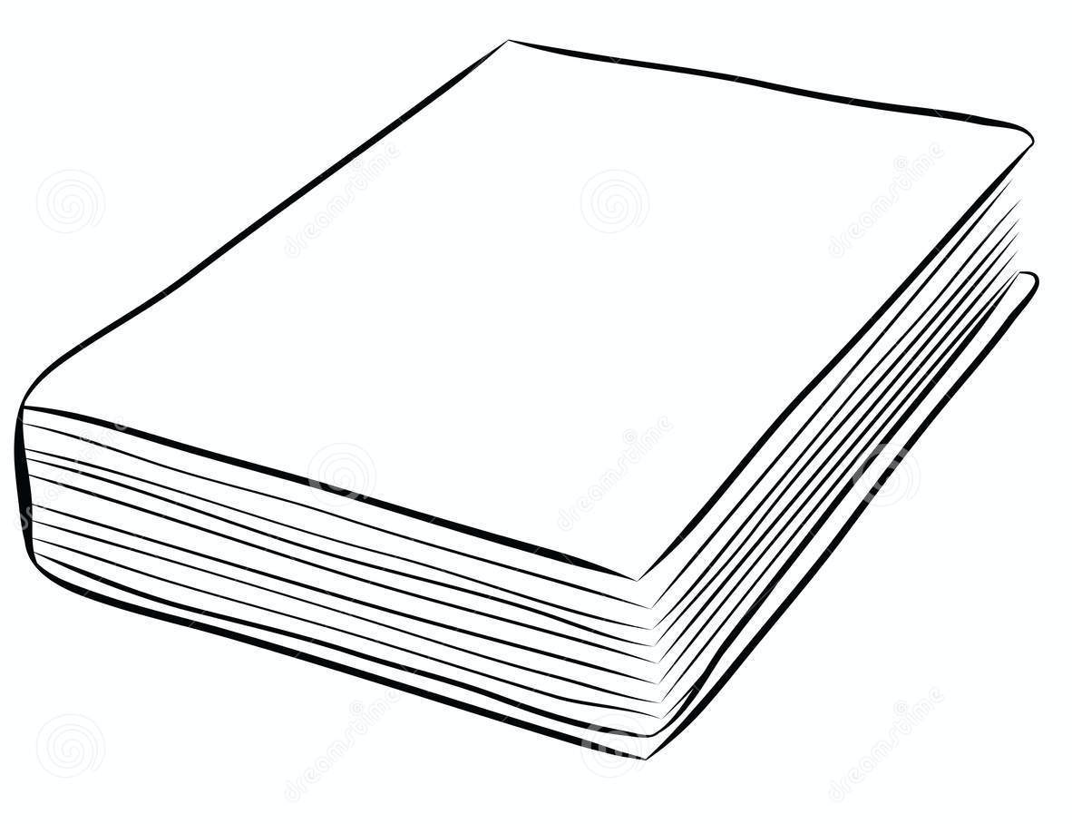

Queue As A Buffer
Subscription: 1 book per week through mail
Me: finish 1 book per MONTH

Slide 40
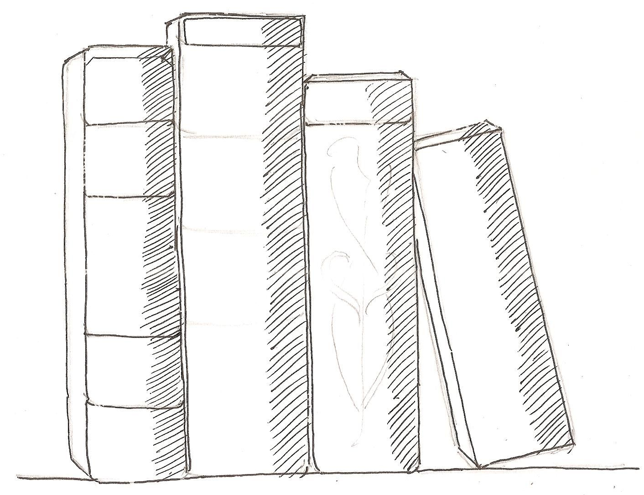
Queue As A Buffer
Subscription: 1 book per week through mail
Me: finish 1 book per MONTH

Slide 41
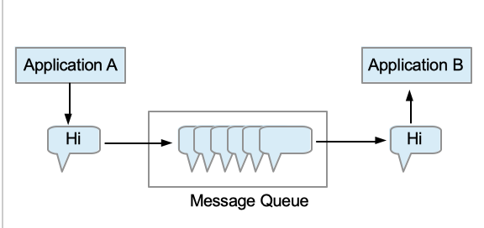
Message Queue
Goal: Allow different applications to work at different speed
Messaging queue (MQ) is used for asynchronous application to application communication.
https://medium.com/@Mohitdtumce/what-is-message-queue-b5468ff6db50

Slide 42
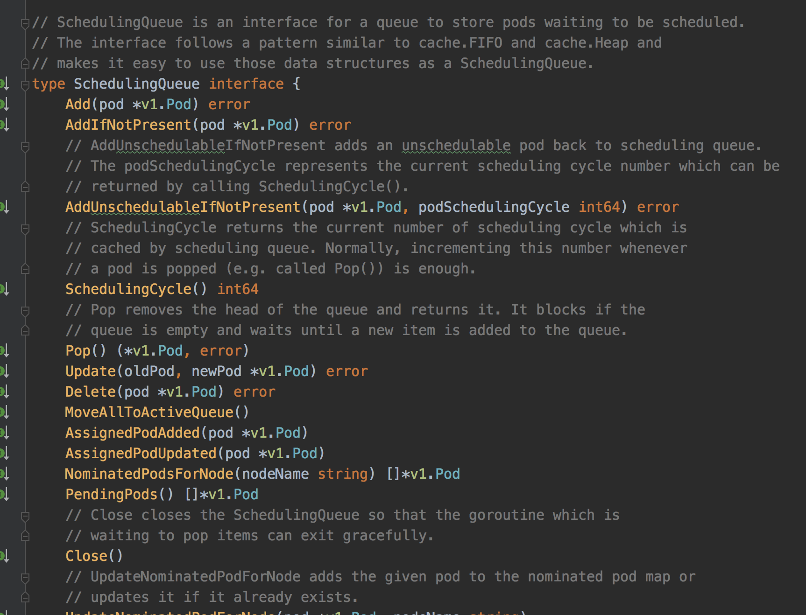
Queue example: Kubernetes Scheduler
pod
pod
pod
pod
pod
pod
pod
pod
Pod Queue
pod
pod
pod
pod
pod
pod
pod
pod
pod
pod
pod
Scheduler
https://github.com/kubernetes/kubernetes

Slide 43
Queue ADT
poll()
12
12
12
1
7
18
10
3
12
1
7
18
10
3
add(…)

Slide 44
ADT Queue
Array Implementation
poll() “get and delete”
“front”
1
2
3
4
5
“end”
add(int) “append”

Slide 45
ADT Queue
Array Implement
1
2
3
4
5
poll()
2
3
4
5
poll()
3
4
5
add(6)
3
4
5
6
add(7)
3
4
5
6
???

Slide 46
0
1
Can we use this spot?
3
5
6
2
3
4
5
6
???
5
4
0
1
2
3
4
5
4
3

Slide 47
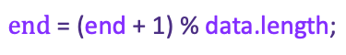
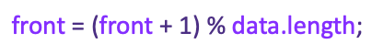
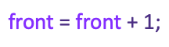
end idx = 0
0
1
$$\text{e}\text{nd}\text{ = (}\text{end}\text{ + 1) \% }\text{data}\text{.}\text{length}\text{;}$$
8
front idx = 2
end idx = 5
6
3
5
2
$$\text{front}\text{ = }\text{front}\text{ + 1}\text{;}$$
$$\text{front}\text{ = (}\text{front}\text{ + 1) \% }\text{data}\text{.}\text{length}\text{;}$$
5
4
front idx = 3
4
3

Slide 48
ADT Queue
Array Implement
1
2
3
4
5
poll()
2
3
4
5
poll()
3
4
5
add(6)
3
4
5
6
add(7)
7
3
4
5
6
add(8)
7
8
3
4
5
6
Full!

Slide 49
ADT Queue
Array Implement
add(6)
3
4
5
6
add(7)
7
3
4
5
6
add(8)
7
8
3
4
5
6
Full!
poll()
7
8
4
5
6
poll() x 4
8/8
poll()
empty

Slide 50
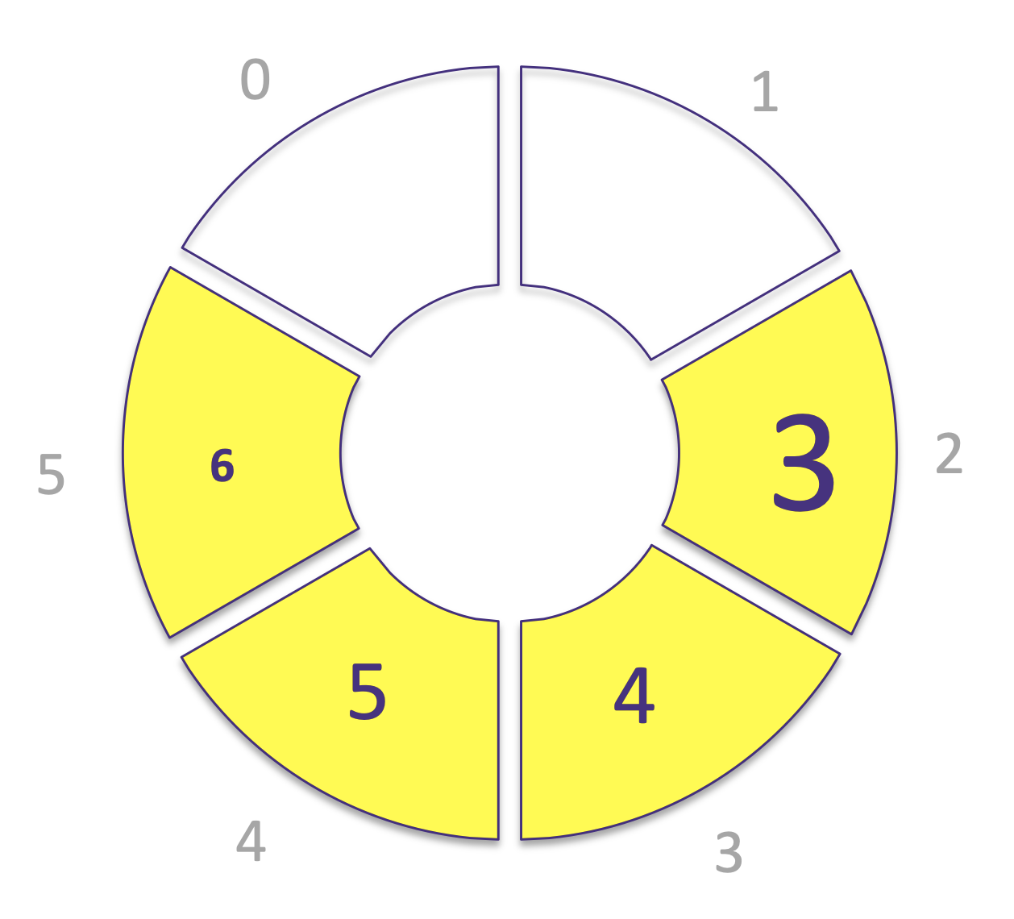
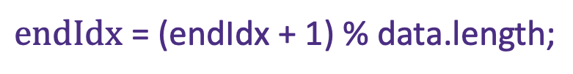
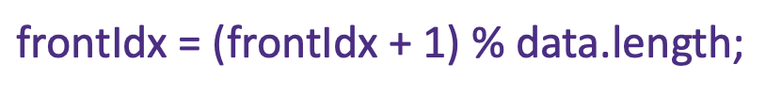
Circular Queue
When poll()
$$\text{front}\text{Idx}\text{ = (}\text{frontIdx}\text{ + 1) \% }\text{data}\text{.}\text{length}\text{;}$$
When add(value)
$$\text{endIdx}\text{ = (}\text{endIdx}\text{ + 1) \% }\text{data}\text{.}\text{length}\text{;}$$

Slide 51
Stack ADT
push(…)
12
12
12
1
7
18
10
3
12
1
7
18
10
3
pop()

Slide 52
ADT: Stack
First In Last Out (FILO)

Slide 53
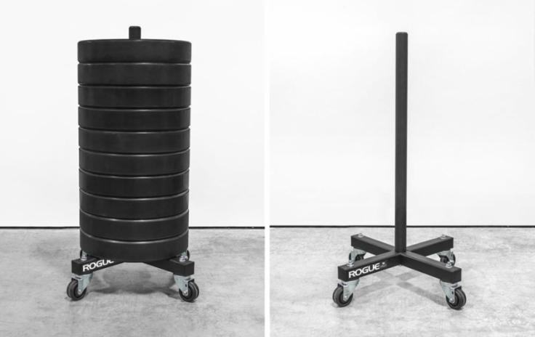
Stack ADT
push(…)
pop()
push(…)
pop()
First In Last Out (FILO)

Slide 54
Stack ADT
push(…)
12
12
12
1
7
18
10
3
12
1
7
18
10
3
pop()

Slide 55
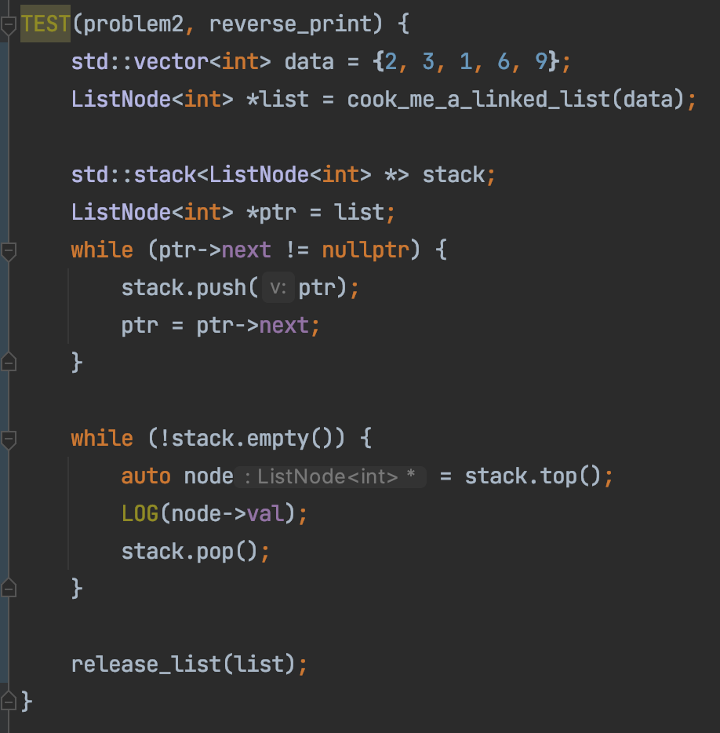
Print a Single Linked List Reversely
1
4
2
nullptr

